Slide 1
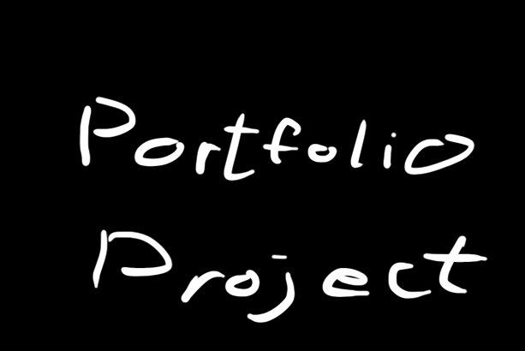
(Portfolio Project)

Slide 2

The goal
Gameplay - Prototype based on grappling hook traversal
Good Player feedback

Slide 3

More Goals
Gather technical knowledge

Slide 4


Must Haves
Movement mechanic
Grappling Hook mechanic
Animations

Slide 5






Should Haves
Gun & Shooting
Targets
UI
Particle effects
(Wallrunning)

Slide 6


Nice to haves
Enemies
Reload animation
More guns
Self modeled gun
Pretty environment

Slide 7
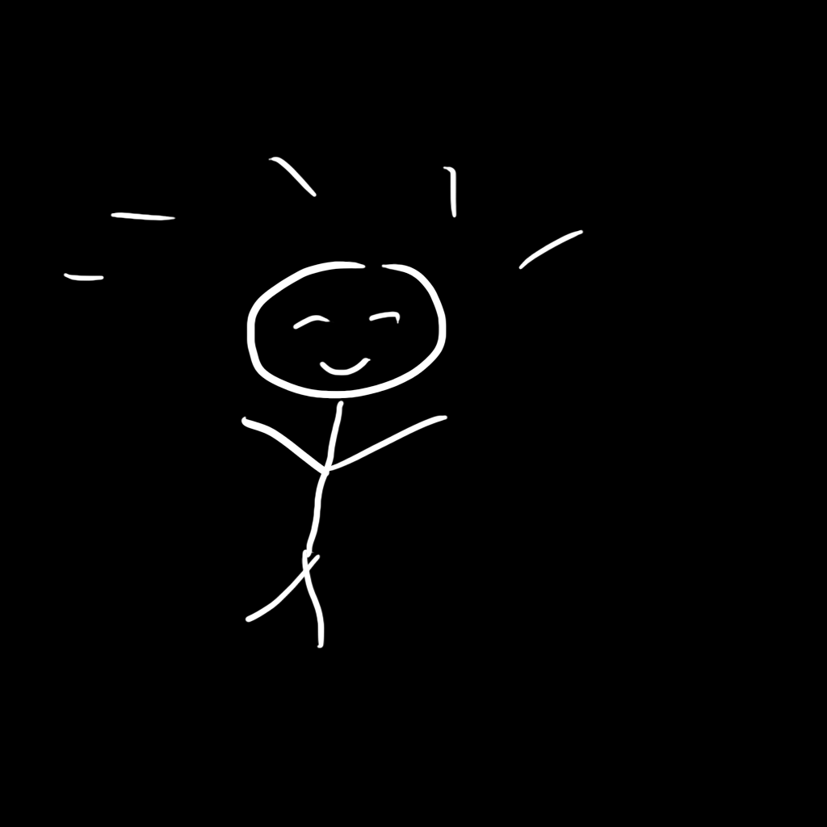
Difficulties / Proud achievements

Slide 8

Wallrun
Custom player movement component
Velocity retention

Slide 9

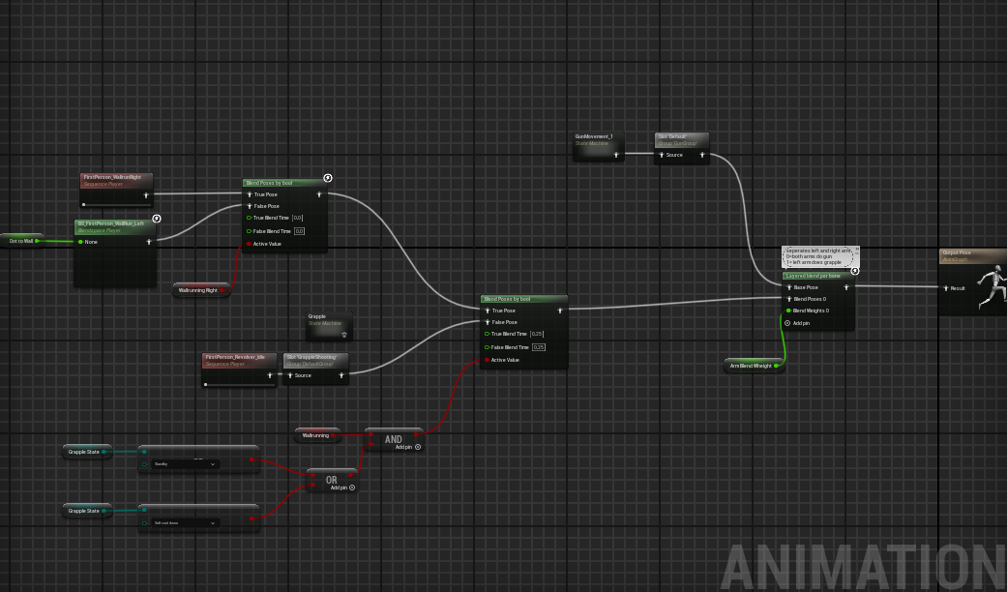
Animations
Player feedback through animation
Reload Animation
Implementaion

Slide 10
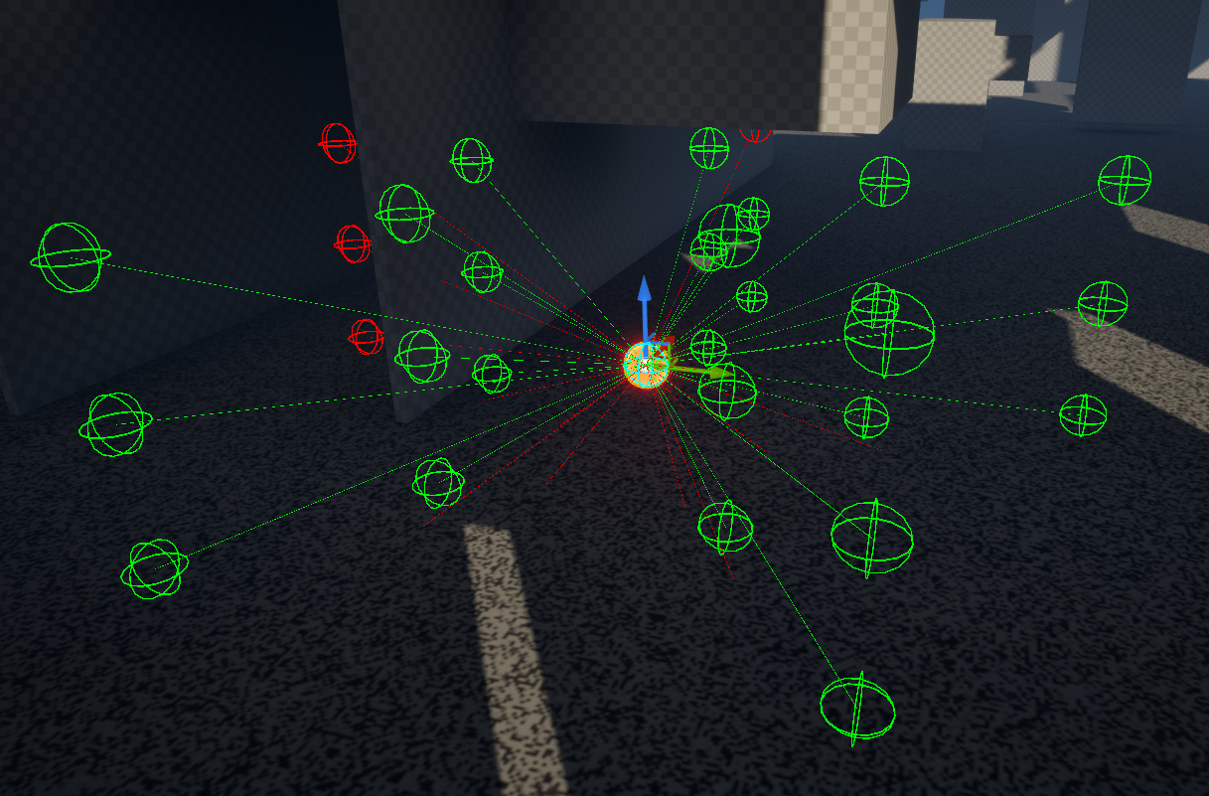
Target
3D obstacle avoiding

